Slide 1
0x206 – Symmetric Encryption
ECED4406 – Computer Security
Dr. Colin O’Flynn
Dalhousie University.

Slide 2
Symmetry?

Slide 3
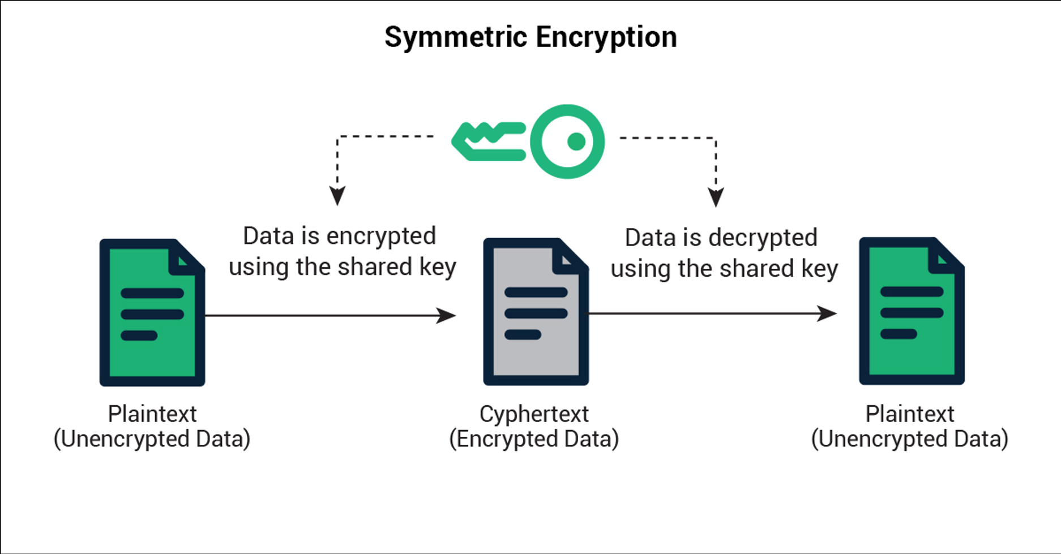
Symmetric Encryption
Symmetric encryption means the same key can perform both encryption & decryption.
Normally the algorithm for encryption & decryption are “mirrors”, but this isn’t a requirement.

Slide 4
Downsides of Symmetric Encryption?
Both sides know the secret key – impossible to determine which side encrypted a message.
Need a secure channel to transmit the secret key between sides to start with.

Slide 5
Advantages of Symmetric Encryption
Generally, the design of symmetric encryption algorithms allows them to be:
Very fast
Think encrypting/decrypting your disk drive, encryption/decryption data on a network, etc.
Fairly “small” in terms of code or hardware area.

Slide 6
Block Ciphers
Many symmetric encryption ciphers are block ciphers.
This always works on a fixed sized block (say, 16 bytes).
Encrypting more than the block size requires multiple runs.
Encryption less than the block size requires padding the input to be the full block size (the algorithms cannot work on smaller inputs).
INPUT DATA
PAD
DATA
DATA
DATA
DATA
DATA

Slide 7
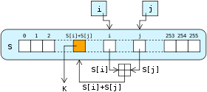
Steam Cipher
Stream ciphers work by encrypting a “byte at a time”, as the data comes.
Almost all stream ciphers work by generating a “key stream”, which is XOR’d with the plaintext to generate the ciphertext.

Slide 8
Specifications of Symmetric Algorithms
Algorithm Dependent:
Block Size → i.e., 128-bit (16 byte).
Key Size -> i.e., 128-bit (16 bytes), 256-bit (32 bytes).
Implementation Dependent:
Bytes encrypted per clock cycle, or Mbytes/second
i.e., an algorithm encrypts one block (16 bytes) in 300 clock cycles of the microcontroller.
16/300 = 0.05333 bytes/cycle
If device runs at 200 MHz:
0.05333 * 200E6 = 10.67 Mbytes/second

Slide 9
Symmetric Algorithms
Algorithm is symmetric if the same key is used for encryption & decryption.
Examples of symmetric algorithms:
AES
DES
3DES
RC4

